Slide 1
K-MER COUNTING
APP
Team
Nadeen Amr Ataa El-Gendy
Rawan Ahmed Ezat El-Sherbiny
Amira Ebrahim MohamedAbdelatif
Manar Gehad EL-awady Grawish
Noran Emad Mohamed EL-Nemr

Slide 2
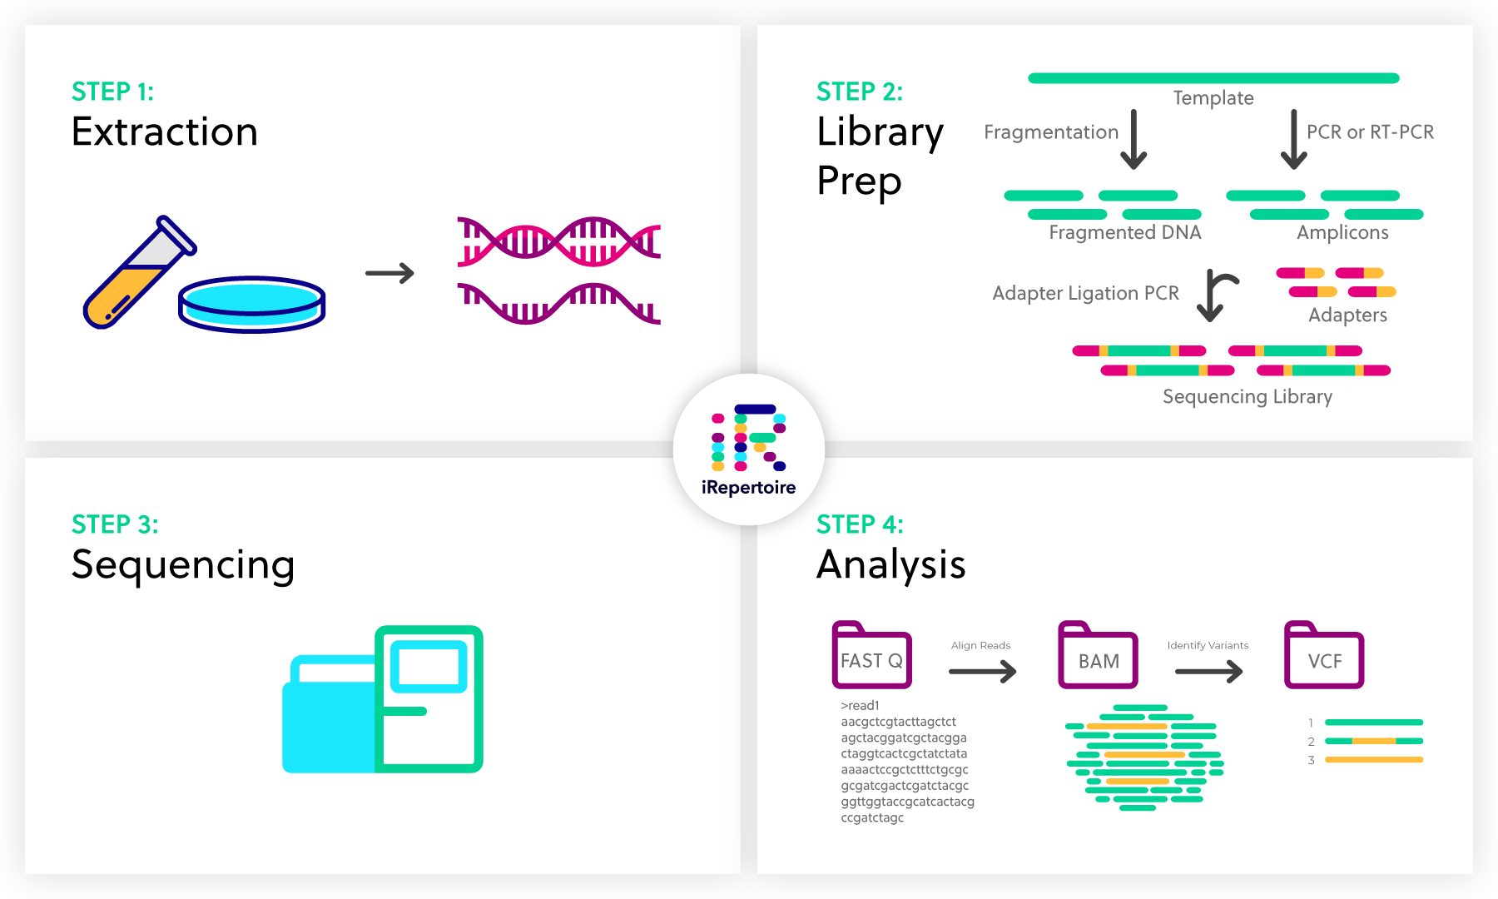
Sequencing pipeline
for a typical DNA sequencing strategy involves aligning the raw reads
from FASTQ,FASTA files against the human reference genome.

Slide 3
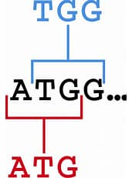
What is k-mer?
Definition
Advantage

Slide 4

The problems
Count k-mer.
Memory.
Time.

Slide 5
The solution
We decide to make Desktop k-mer counting app
that allow us to:

Slide 6
Choose k-mer length and extract it from genome .
Report num of
k-mers .
Make efficient use of memory.
Extract and approximate
k-mer count.

Slide 7
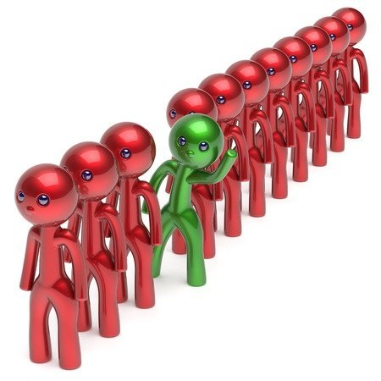
COMPETITORS AND DIFFERENCES
we will make the tool as a desktop application which is more efficient .
we will take care about the required time and memory for the process.

Slide 8
GUI
browse
choose file:
Enter k-mer length:
Get the count

